Slide 1


Lecture 1: Introduction to Machine Learning
PUSL3123 AI and Machine Learning
Neamah Al-Naffakh
School of Engineering, Computing and Mathematics
Neamah.al-naffakh@plymouth.ac.uk

Slide 2
Today’s Topics
Introduction to Machine Learning (ML)
Lesson learning outcomes: By the end of today’s lesson, you would be able to:
Understand the basic concepts in unsupervised, supervised and reinforcement learning
Understand how does machine learning work?

Slide 3
What is Machine Learning?
What is “Learning”?
Dictionary definition: “the process or experience of gaining knowledge or skill through study, experience, or being taught”.
An example of learning is a student understanding and remembering what they've been taught, learning how to drive, learning how to recognise digits
Can a Machine “Learn”? E.g., learn from data or learn from past experience?

Slide 4
What is Machine Learning?
(Arthur Samuel, 1959) concluded that “a computer can be programmed so that it will learn to play a better game of checkers than can be played by the person who wrote the program.”
With algorithms
Learn from Experience E
Achieve some task/s T
Improve their performance P

Slide 5
What is Machine Learning?
Example: SPAM email filtering
Collect emails which have been labelled as spam or non-spam –E
Classifying emails as spam or non-spam and putting them into the right folder –T
Calculate the percentage of emails correctly classified as spam or non-spam -P
Machine Learning is the study of computer algorithms that improve automatically through experience.

Slide 6
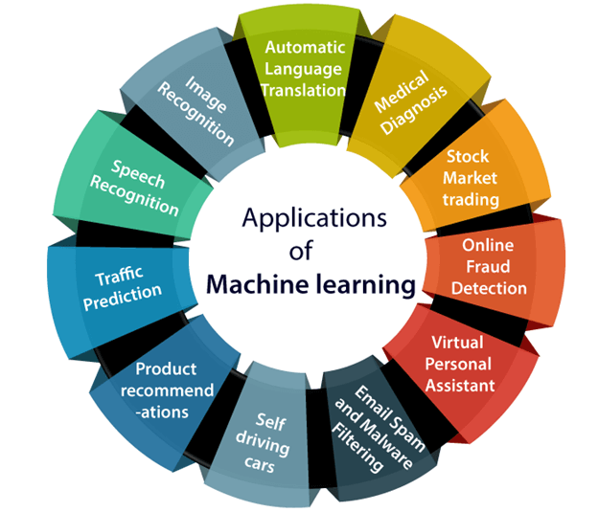
Applications of Machine learning

Slide 7
Applications of Machine learning
Image Recognition
Identify objects, persons, places, digital images, etc
Speech Recognition
Speech recognition is a process of converting voice instructions into text, and it is also known as "Speech to text", or "Computer speech recognition.“. For example, Search by voice in Google

Slide 8
Applications of Machine learning
Traffic prediction:
Using Google Maps to find out the correct path with shortest route and predicts the traffic conditions. This can be achieved with the help of two inputs:
Live GPS information of the vehicle
Average time has taken on past days at the same time.

Slide 9
Applications of Machine learning
Medical Diagnosis
Machine learning is used for Disease identification. For example, It helps in finding brain tumors and other brain-related diseases easily.
Self-driving cars
One of the most exciting applications of machine learning is self-driving cars. For example, Tesla (i.e., car manufacturing company) is working on self-driving car by using unsupervised learning method to train the car models to detect people and objects while driving.

Slide 10
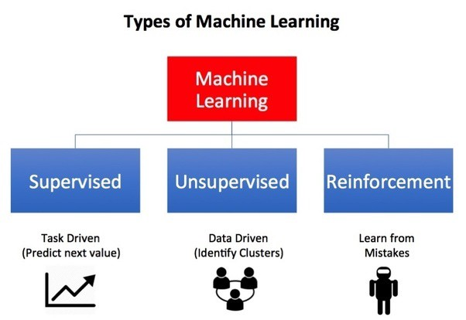
Types of Machine Learning

Slide 11
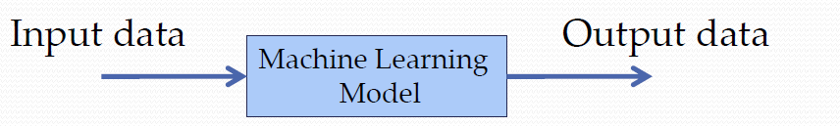
Supervised Machine Learning
Supervised Learning: given samples of input data and output data, machine to learn relationships between them, and then be able to predict output from unseen input data
The machine learns under the guidance of labeled data i.e. known data
It is based upon the training dataset, and it improves through iterations.
Classifying massive data with supervised learning is difficult

Slide 12
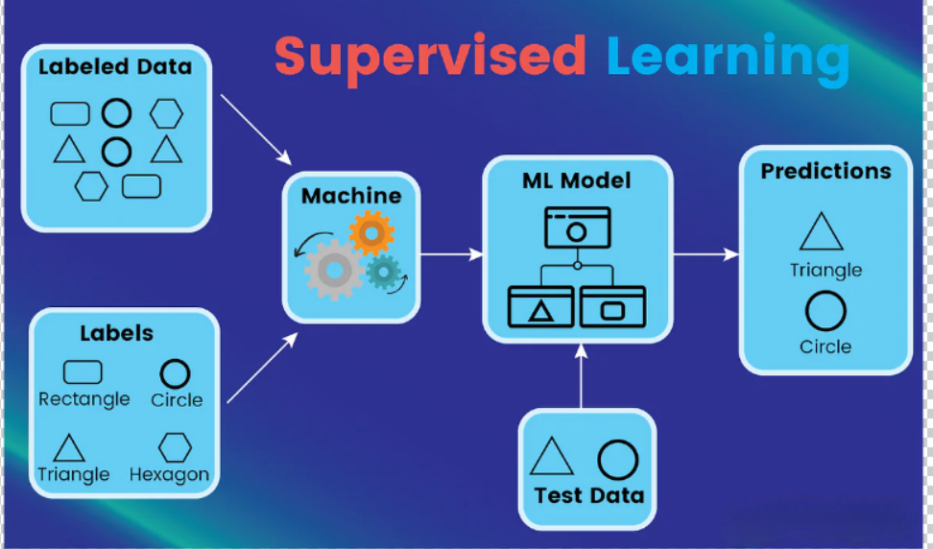
Supervised Machine Learning

Slide 13
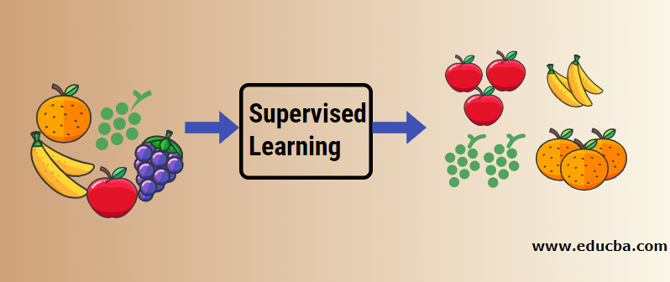
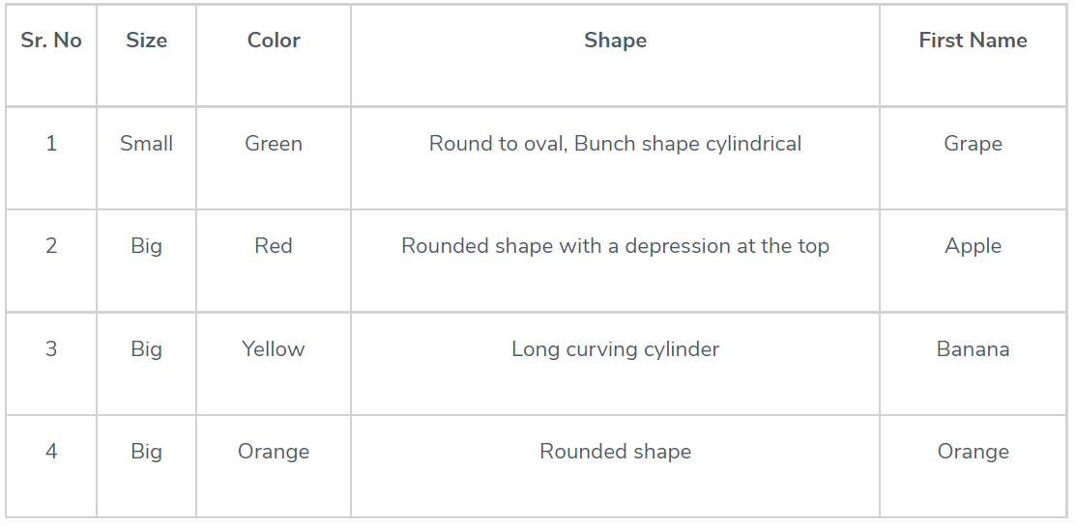
Supervised Machine Learning
For example, the images of fruits can be tagged as apples,bananas, grapes or Oranges.

Slide 14
Supervised Machine Learning

Slide 15
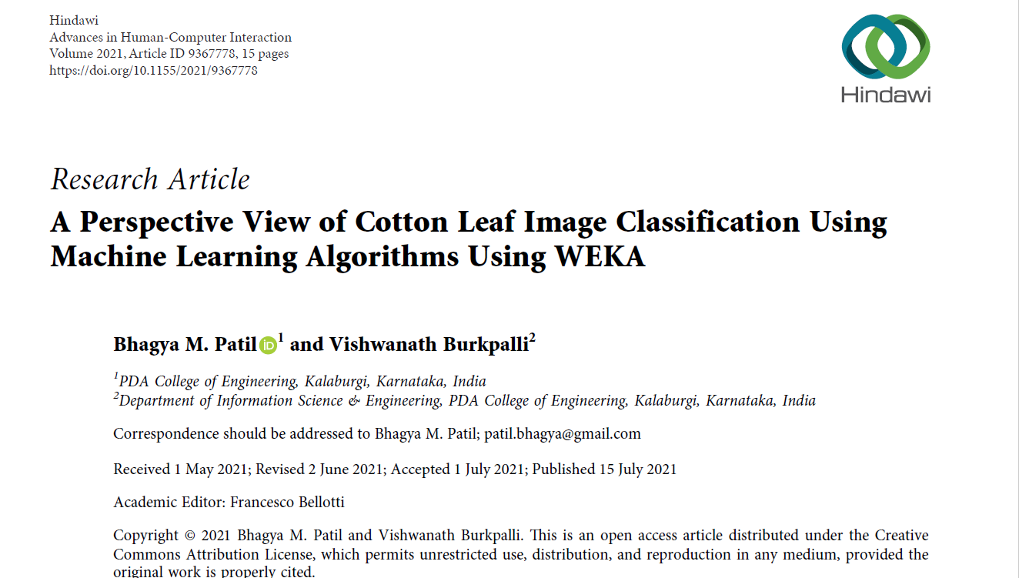
Supervised Machine Learning- Case study

Slide 16
Supervised Machine Learning- Case study
Identifying plant diseases at the early stage good for preventing unnecessary crop loss.
The leaf is the part that affects the crop yield if it gets affected.
Traditionally, disease identification is performed by an expert by taking a leaf sample and analysing it.
Automatic detection of disease will help the farmers to overcome the yield loss.

Slide 17
Supervised Machine Learning- Case study
Dataset consists of 300 cotton images captured with a natural background under controlled conditions.
Healthy images (n=150) and diseases (unhealthy images, n =150)
Diseases captured include:
Alternaria
Grey Mildew
Cercospora

Slide 18
Supervised Machine Learning- Case study
Healthy leaf
Unhealthy leaf

Slide 19
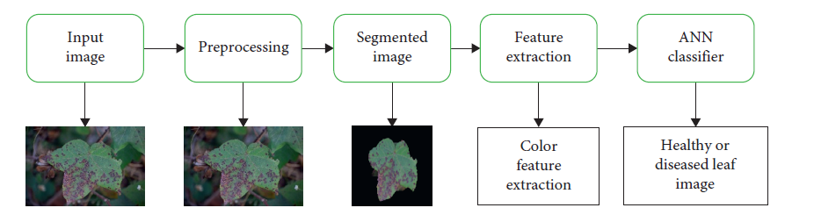
Supervised Machine Learning- Case study
Task: classification

Slide 20
Unsupervised Machine Learning
Unsupervised Learning: Only given input data without known output data, machine to learn latent/hidden relationships within the data and make decisions.
It’s a self-organized learning algorithm (no labelled data is required).
Algorithm would be fed a lot of data and given the tools to understand the properties of the data.
Unsupervised Learning an interesting area is that an overwhelming majority of data in this world is unlabeled

Slide 21
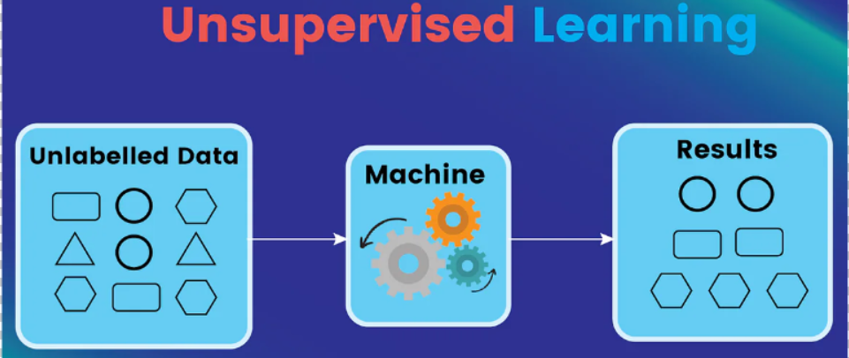
Unsupervised Machine Learning

Slide 22
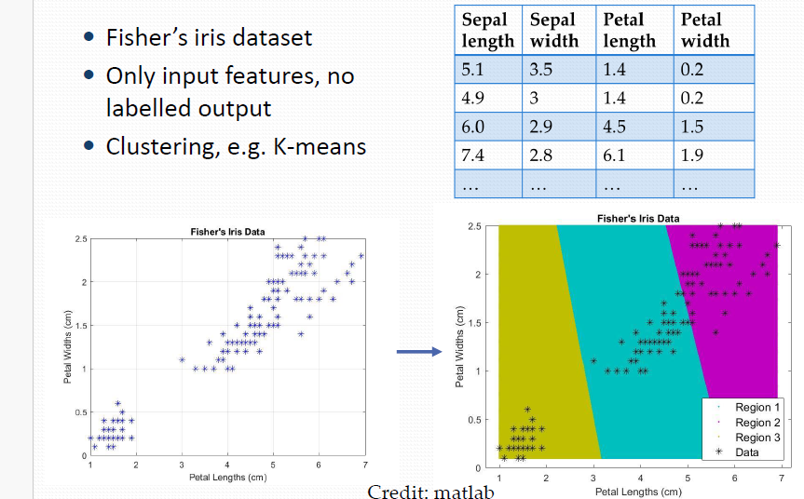
Unsupervised Machine Learning - Clustering

Slide 23
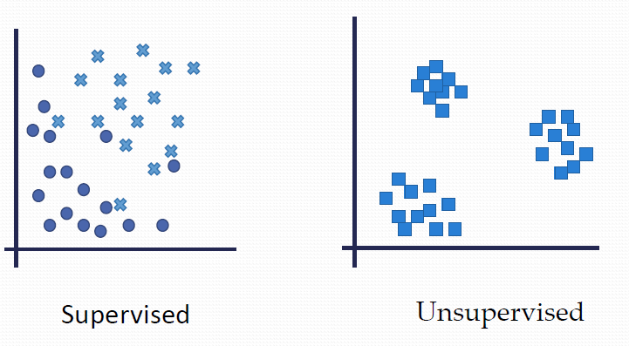
Use of Unsupervised Machine Learning
Outlier detection –to detect outlier in noisy datasets
Detect fraud, find anomalies in the credit card usage
Detect abnormal behaviour (malicious or unintentional) in systems/networks
Detect tumour from medical imaging data

Slide 24
Intrusion Detection System using ML
Monitor networking traffic, detect network attacks (e.g. DDoS attack) using ML techniques.
Case 1: There are 20,000 networking traffic sessions captured with each session labelled as ‘Normal’ or ‘Attack’. You need to develop a ML model to detect network attacks based on the existing labelled dataset.
Which machine learning technique to use?
a) Supervised Learning
b) Unsupervised Learning

Slide 25
Intrusion Detection System using ML
Case 2: You need to develop a ML model to detect abnormal network traffic which might indicate a new unknown attack.
Which machine learning technique to use?
a) Supervised Learning
b) Unsupervised Learning

Slide 26
Reinforcement Learning
Reinforcement Learning: get machine to learn by itself via trial and error, interact with environment, and take actions to achieve a final goal.
Reinforcement learning comprises three significant components: agent, environment, and actions.
The Agent: the learner/decision-maker
The Environment: anything the agent interacts with
The Actions: what the agent does

Slide 27
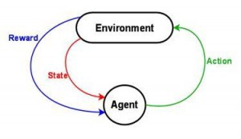
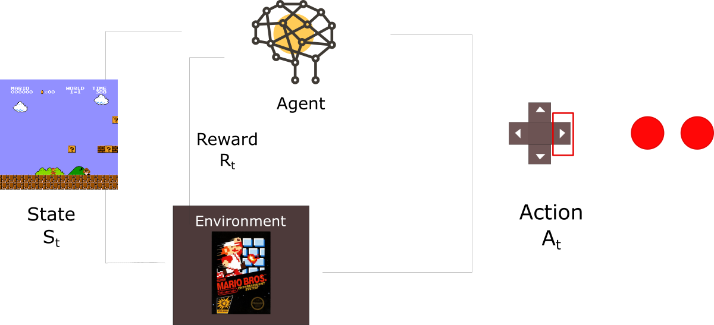
Reinforcement Learning

Slide 28
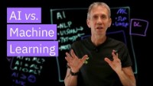
The Difference between ML & AI

Slide 29
How Does Machine Learning Work?
Choose and Prepare a Training Data Set
Select an Algorithm to Apply to the Training Data Set
Train the Algorithm to Build the Model
Use and Improve the Model

Slide 30
1- Choose and Prepare a Training Data Set
Training data is also known as training dataset, learning set, and training set
Training data is the initial data used to train machine learning models.
Without high-quality training data, even the most efficient machine learning algorithms will fail to perform.
Training data can be classified into two categories: labeled data and unlabeled data.

Slide 31
Labelled data VS Unlabelled data?
Labelled data
It is a group of data samples tagged with one or more meaningful labels. Labels used to identify specific characteristics, properties, classifications, or contained objects.
Labelled training data is used in supervised learning.
Data labelling is a time-consuming process as humans need to tag or label the data points.
Unlabelled data
It is raw data or data that's not tagged with any labels for identifying classifications, characteristics, or properties
Unlabelled data used in unsupervised machine learning

Slide 32
2- Algorithm Selection
The selection process of machine learning algorithm depend on a few aspects
Whether the use case is prediction or clustering
How much data is in the training set
The nature of the problem the model seeks to solve

Slide 33
3- Train the Algorithm to Build the Model
Setting model variables and parameters to more accurately predict the appropriate results.
Using a variety of optimization methods depending upon the chosen model.

Slide 34
4- Use and Improve the Model
Feed new data to the model as a means of improving its effectiveness and accuracy over time.
Feature Engineering which create new features from the existing ones.
Feature Selection that helps to identify the most useful features in the dataset.
Try Multiple Algorithms to identify which ones work best for data and then use that information to improve the accuracy of models.
Adjusting Hyperparameters such as number of layers in a deep neural network).
If the prediction and results don’t match, re-train the algorithm multiple times until getting the desired outcome

Slide 35
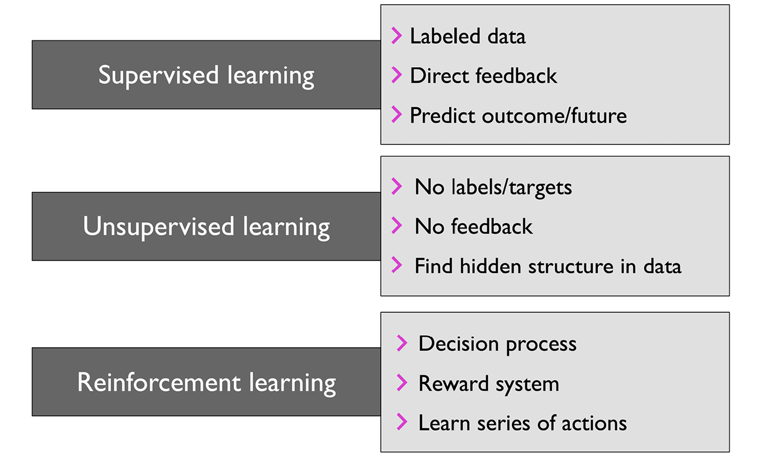
Conclusion

Slide 36
Reading List
Christopher M. Bishop: Pattern Recognition and Machine Learning,Springer, 2006.
Kevin Murphy, Machine Learning: A Probabilistic Perspective, MIT Press, 2012. (e-book available via Primo)
Richard S. Sutton, and Andrew G. Barto, Reinforcementlearning: An introduction. 2ndEdition. MIT press, 2018. (e-book available via Primo)
Tom Mitchell, Machine Learning, McGraw-Hill, 1997.
Ian Goodfellow, YoshuaBengioand Aaron Courville, Deep Learning, MIT Press, 2016. (online version available).

Slide 37
About Lab/Matlab
How to access Matlab
Install Matlab at home
Access Matlab online
Get familiar with Matlab
Matalb introduction file
Matlab introduction lab 1 material
About Lab/Matlab Please spend some time on getting familiar with Matlab

